Slide 1
Parallelizing Neural Network For High-Frequency Stock Forecast
Chang Liu, Linglin Huang, Greyson Liu, Kamrine Poels
CS 205 Final Project Presentation

Slide 2
Outline
Background and data
Parallel Structure
Algorithm
Results and conclusions
Future work

Slide 3
Background and Data
Increasing availability (and profitability) of high-frequency data
Promising predictive power of neural network
Computational intractability of the combining both
Problem: Train a multi-layer fully-connected network
Inputs: Technical indicators of Goldman Sach’s stock price (EMA, Momentum, Volatility, etc)
Output: next-second percentage change in price
Notes:
Parallel neural network has also been a topic of great interest. There are generally two paradigms of parallelisation: data parallelism and model parallelism. Data Parallel is straightforward. Its correctness is mathematically supported, and is very commonly implemented with MPI [4]. Model parallel is more complicated. For large models that include millions to billions of parameters, the whole neural network is partitioned across different machines, and usually implemented with openMP and GPU. For our intended purpose, we can fit the whole network into one machine so that parallelism is applied to the largest computational bottleneck - BLAS operations in the backpropagation algorithm.

Slide 4
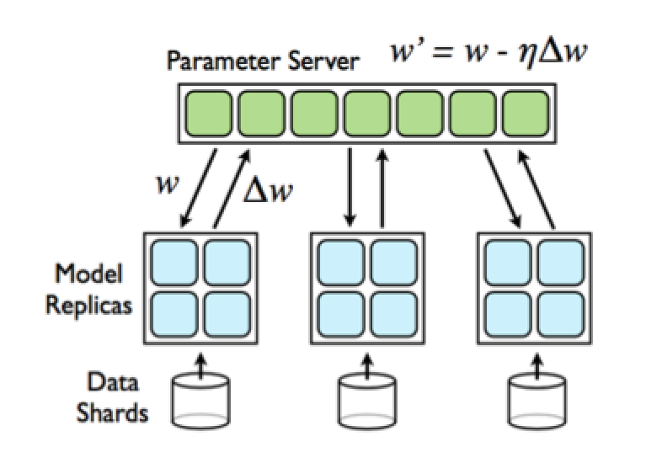
Two-level Parallel Structure - Level 1: MPI

Slide 5
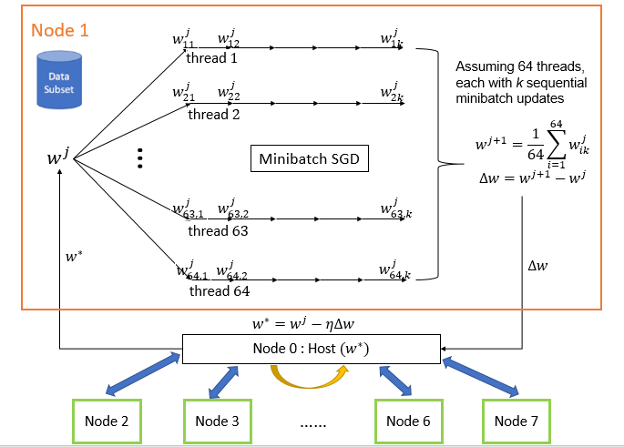
Two-level Parallel Structure - Level 2
Option 1: OpenMP

Slide 6
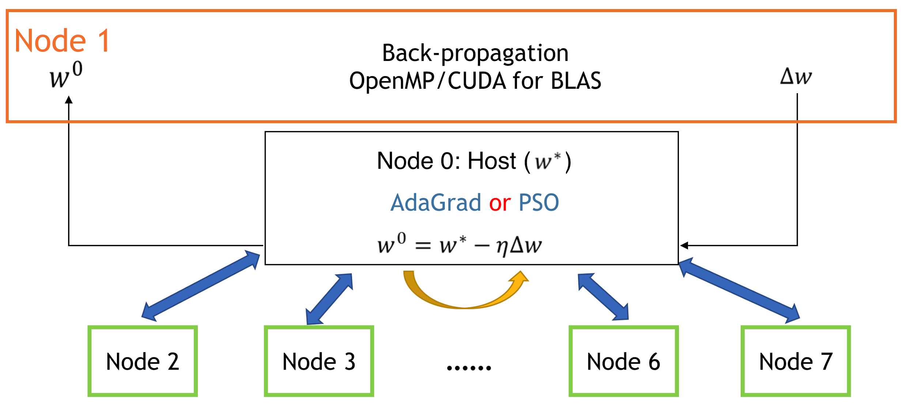
Two-level Parallel Structure - Level 2
Option 2: : OpenMP/CUDA

Slide 7
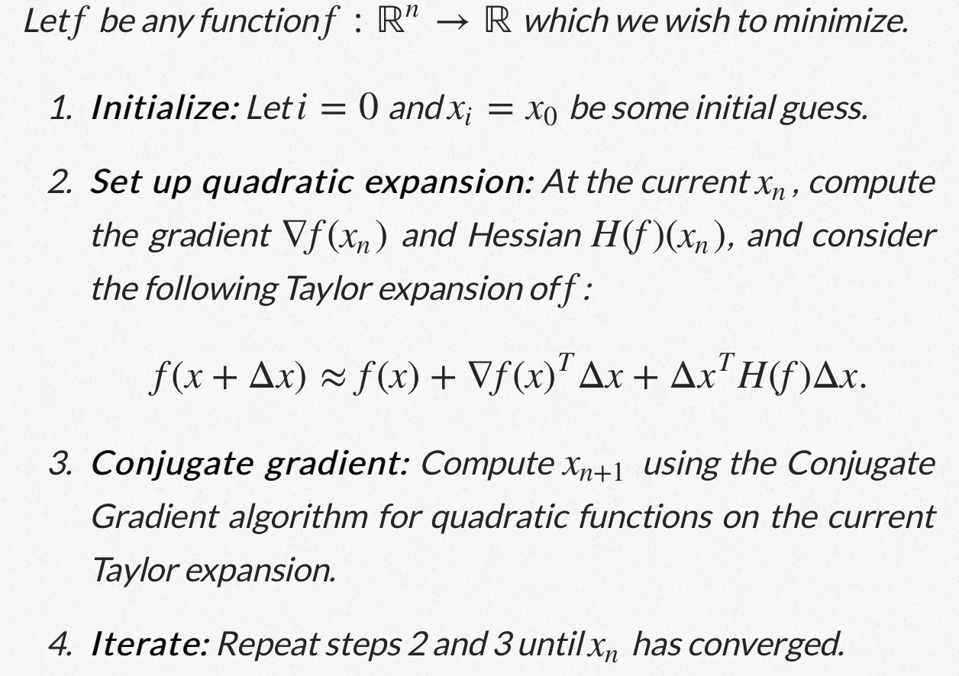
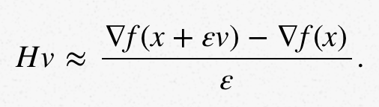
Algorithms
Hessian-Free from hessianfree
Updates along with Conjugate Gradient. No need to calculate H, but Hv can be approximated.
Notes:
In Newton’s method, we need the inverse of the hessian for optimization, but the hessian is basically a negative double derivative of the likelihood of the model
Hessian-free is frequently used in conjugate gradient optimization (used to optimize quadratic equations, in this case f()). Delta f is a linear equation of x.
Unlike newton’s method where no restrictions are placed on f()
Hessian-free is approximated using finite differences
Less tweaking of parameters than SGD, so could show faster convergence but less accurate results

Slide 8
Algorithms continued
Adaptive Gradient (AdaGrad, ADA) from Keras
Modified Stochastic Gradient Descent (SGD) with parameter learning rate
Informally, this increases the learning rate for more sparse parameters and decreases the learning rate for less sparse ones
Parameters that get few or small updates get receive higher learning rates
Two message passing schemes:
Instant updating (1 iteration)
Model replica runs one iteration of gradient weight before communicating with master node
Cumulative updating (20 iterations)
Model replica runs 20 iterations of gradient weight before communicating with master node

Slide 9
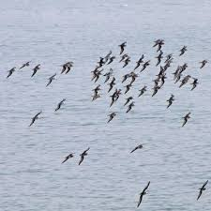
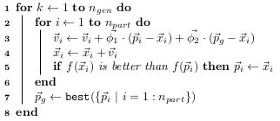
Algorithms continued
Particle Swarm Optimization (PSO)
Global search
Hybrid possible
Notes:
Global search: shown in pseudocode.
Particles move around in a search space in a probabilistic method
Phi_1 is the component for a local search related to that particle
Phi_2 is the component for a global search or the search-space
The probability of mobility around the search space allows the particles to escape local minima or maxima
Hybrid: in addition to global search, there was a gradient method added which allows the algorithm to converge faster.

Slide 10
Results and conclusions
Experiments:
Hessian-free
sequential
CUDA with 1 GPU
PSO
sequential
multiprocessing n CPUs
ADA (batch size 1024 and 4096)
sequential
CUDA with 1 GPU
MPI + OpenMP with 3~8 nodes x 4 cores each node

Slide 11
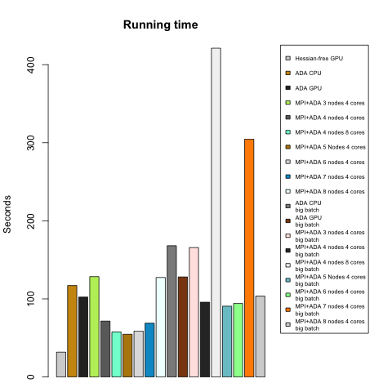
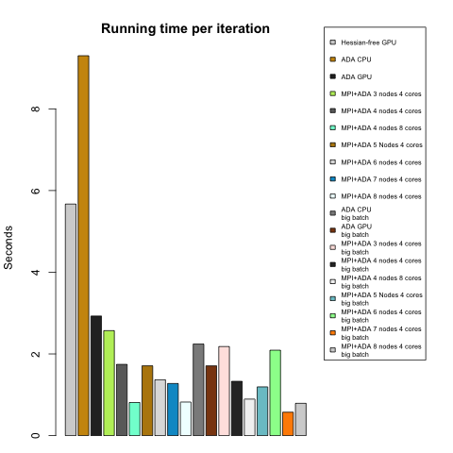
All experiments
Notes:
Figure 4 and 5 compares the running time till convergence and average running time per iteration respectively. We conclude that Hessian-free with GPU performs the best in terms of total runtime till convergence. As for Adjusted gradient (ADA) methods, though each iteration runs fast on average, they usually need more iterations to converge, and variance of the number of iterations is large. These observations fit our expectation because ADA based methods are more stochastic.

Slide 12
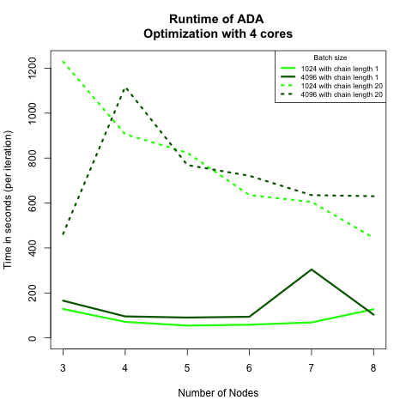
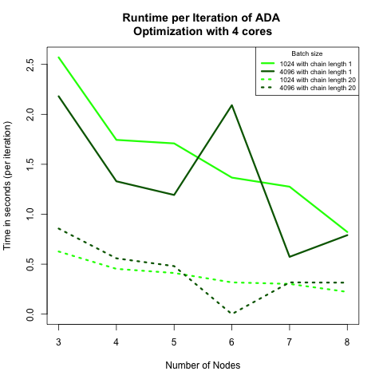
Strong Scaling
Notes:
Figure 6 is about the strong scaling. Left: Total time until convergence by node for all ADA algorithms run with 4 cores. Right: average runtime per iteration. Dashed curves belong to algorithms with chain length = 20, namely each model replica had to run 20 iterations before pushing gradient weight to master node. Solid curves are algorithms with chain length = 1.
We find that in both graphs the batch size does not affect the runtime too much. This suggests in each model replica, matrix computations are well handled, and is not a bottleneck of our algorithm.
Comparing the curves for different chain lengths, we see that chain length = 1 (instant updating scheme) leads to longer average per iteration time, but shorter overall convergence time. We think this is because when chain length is shorter, we have more message passings, and hence more communication overhead. In the meanwhile, the whole model is closest to the sequential model. It makes use of data in all data shards, and therefore converges with fewer iterations. We suppose that if the communication cost is high (internet speed, data chunk sizes, communication barriers, etc.), the cumulative updating scheme could outperform the instant version.

Slide 13
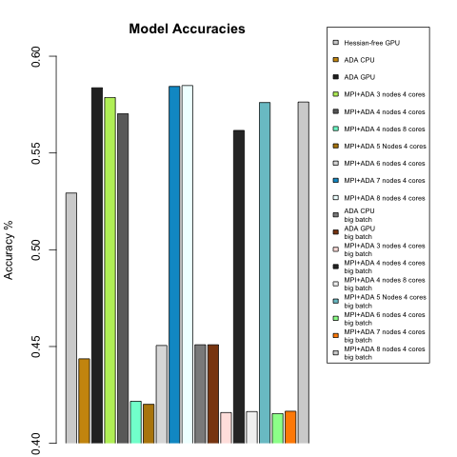
Notes:
In this figure, we examined the predictive accuracy of our models. The baseline accuracy is ~40%. We find none of these methods give high accuracies (e.g. >80%).
A worrying observation is that MPI based models seem to have higher variances in accuracies. We find the loss metrics is actually very similar for all these models, so we think it’s partly because the stock price data is inherently hard to predict, and the algorithms easily converges to some local optima. It could be helpful to run model “multiple times”, by shuffling and re-scattering data to data shards. Aslo, we could probably gain higher accuracies if we have larger input dimensions (e.g. more indexes, make use of time dependencies of timestamp data, etc.) or more suitable network structures (e.g. dropouts, recursive neural networks, deeper network, etc.)

Slide 14
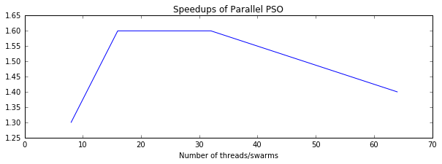
Hybrid Particle Swarm Optimization
100 swarms: 3036 seconds to reach convergence
Goal: parallelizing swarms takes 30 seconds?
Notes:
But we found in our implementation in multiprocessing module in python that speedups are not very significant, let alone linear scaling partly because of the module-specific overheads of creating and merging the threads, partly because of the problem size not large enough now that we don’t have expensive computations as in backpropagation.

Slide 15
Initialize 100 swarms with AdaGrad
120
50
100
150
Update 100 swarms with PSO
120
150
100
50
Notes:
We created a hybrid sys that combines AdaGrad abd PSO, AdaGrad and gradient methods are good at local search, and PSO because it adds randomness to the search, is good at global search. the hybrid sys is [talk about Algo] It take 3000 seconds for 100 swarms to converge (too long compared to others). More swarms, better accuracy and possibly faster convergence. Because the problem size scales linearly with the number of swarms and updating each swarm is independent of each other, if we match the threads with swarms, then we should ideally take 20s to reach convergence, and have the potential for parallelism to outperform other methods.

Slide 16
Future Work
Parallelize PSO in Cython
Alternating PSO + AdaGrad
Vary cumulative updating parameters (number of iterations to run for each model replica before pushing gradient weight to master node) for latency hiding.
Data rescattering to achieve higher accuracies and/or node failures.
Notes:
As mentioned, future work should include parallelizing PSO in cython, and a more advanced hybird sys by alternating between PSO and Adagrad algorithm: when we have a good position via PSO global search, we deep dive into the neighbor of best position AdaGrad; if we found a better position, we replace the worst swarm with it; otherwise, we continue our global search.

